Slide 1
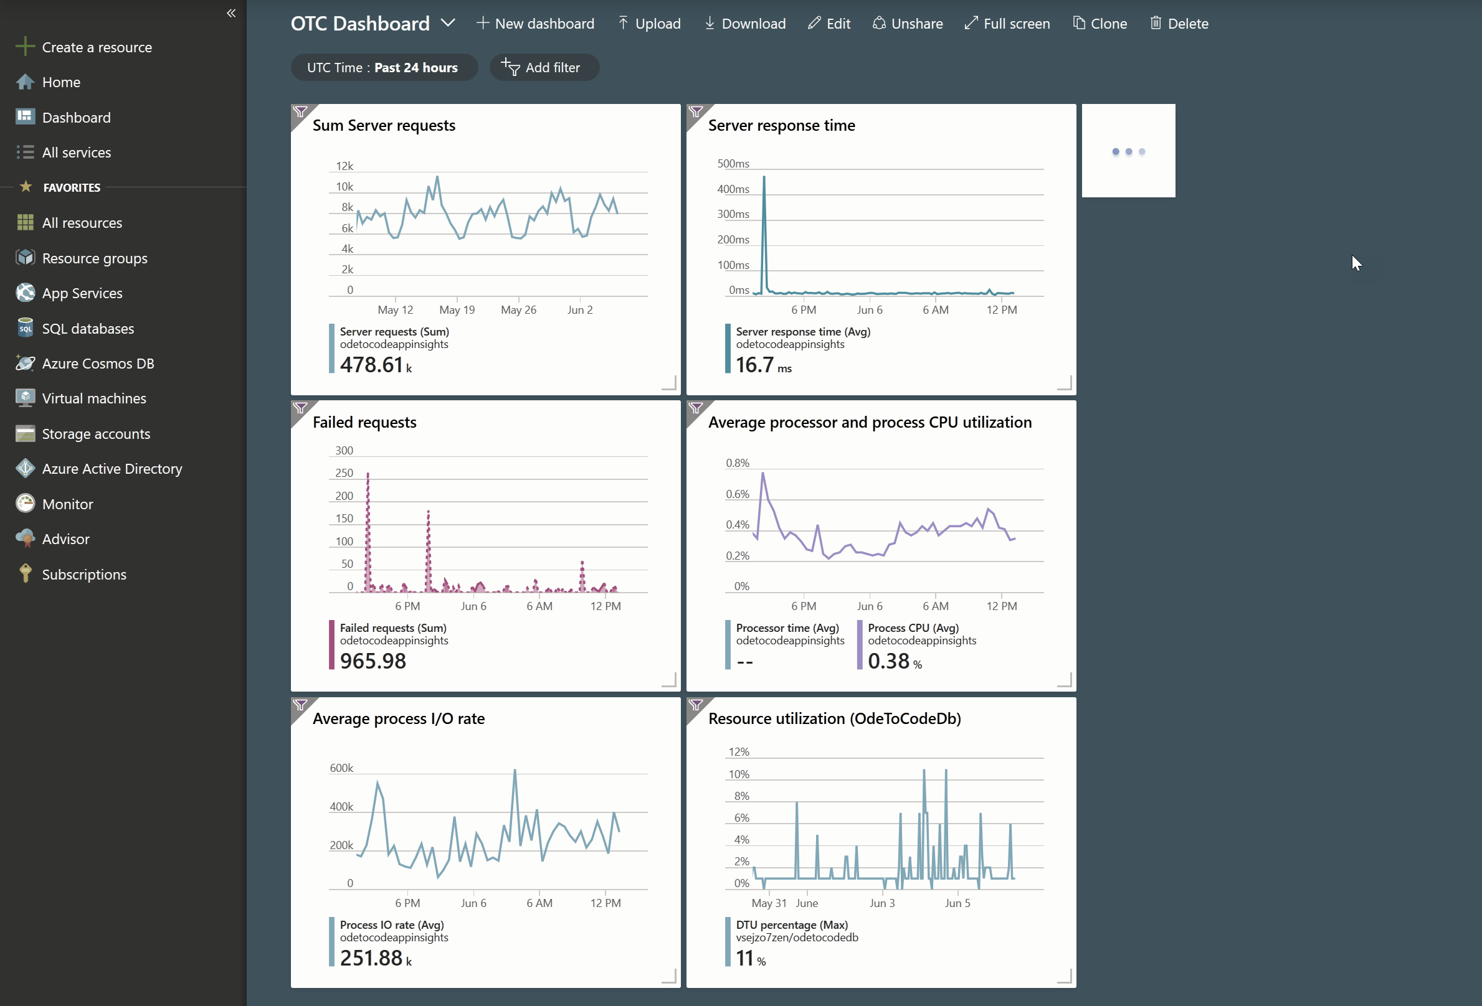

Advanced Azure App Services
K. Scott Allen
@OdeToCode

Slide 2

If you talk HTTP/S, App Services can be your host

Slide 3


App Services is a platform
IaaS
PaaS
SaaS

Slide 4
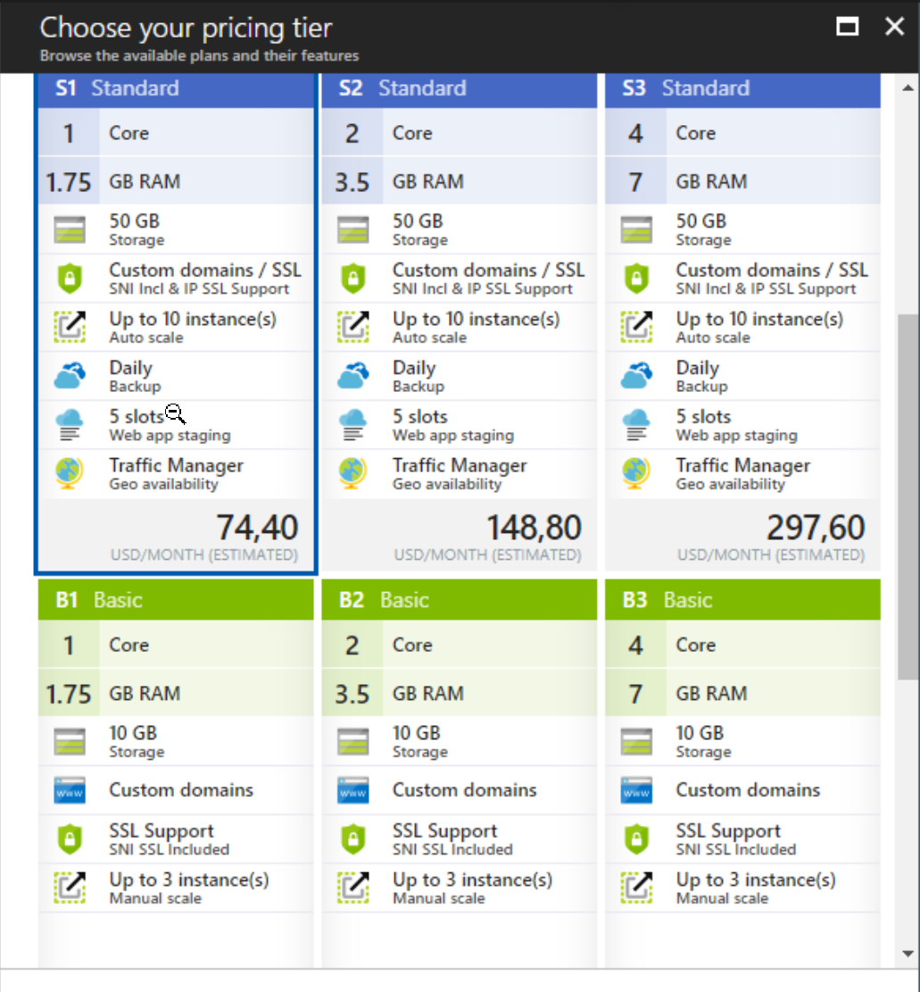
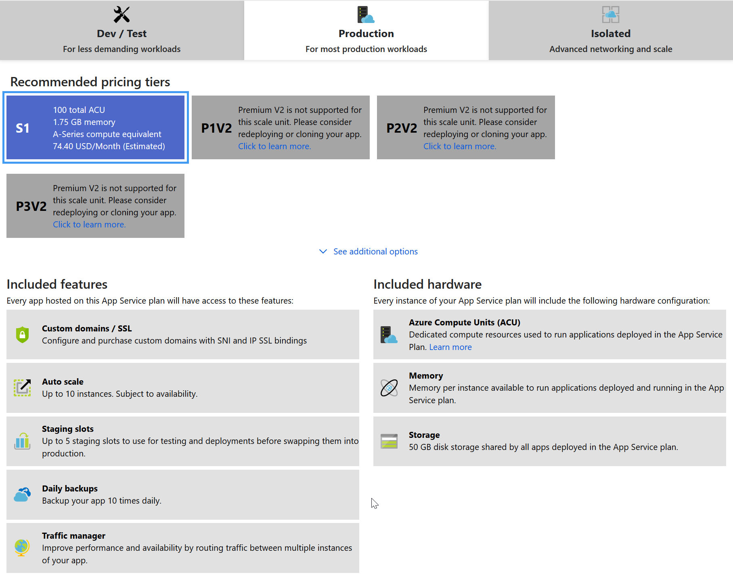
App Services is an abstraction
Old Price Cards
New Price Cards

Slide 5
App Services is an abstraction
SKUs

Slide 6
Agenda
Physical characteristics
Logical architecture
Performance
Diagnostics

Slide 7

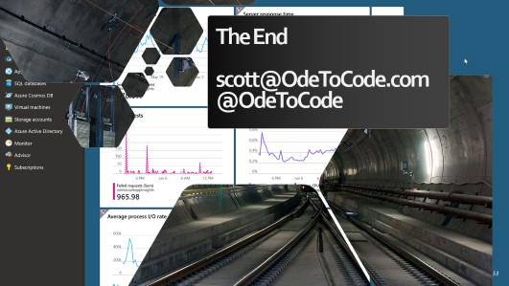
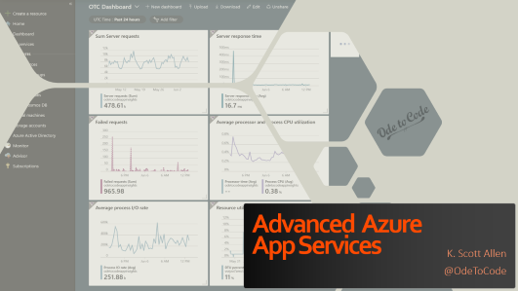
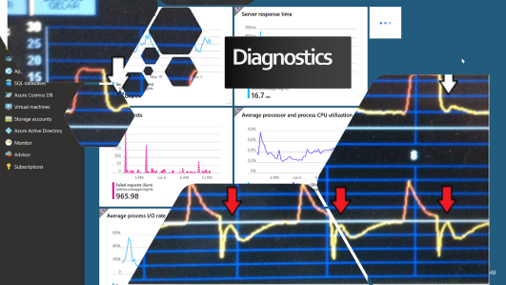
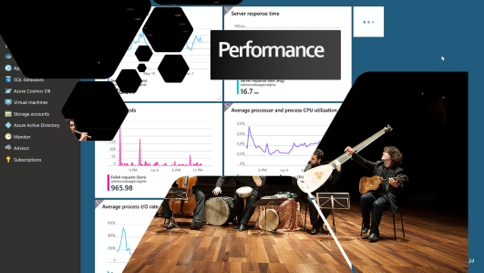


Slide 8
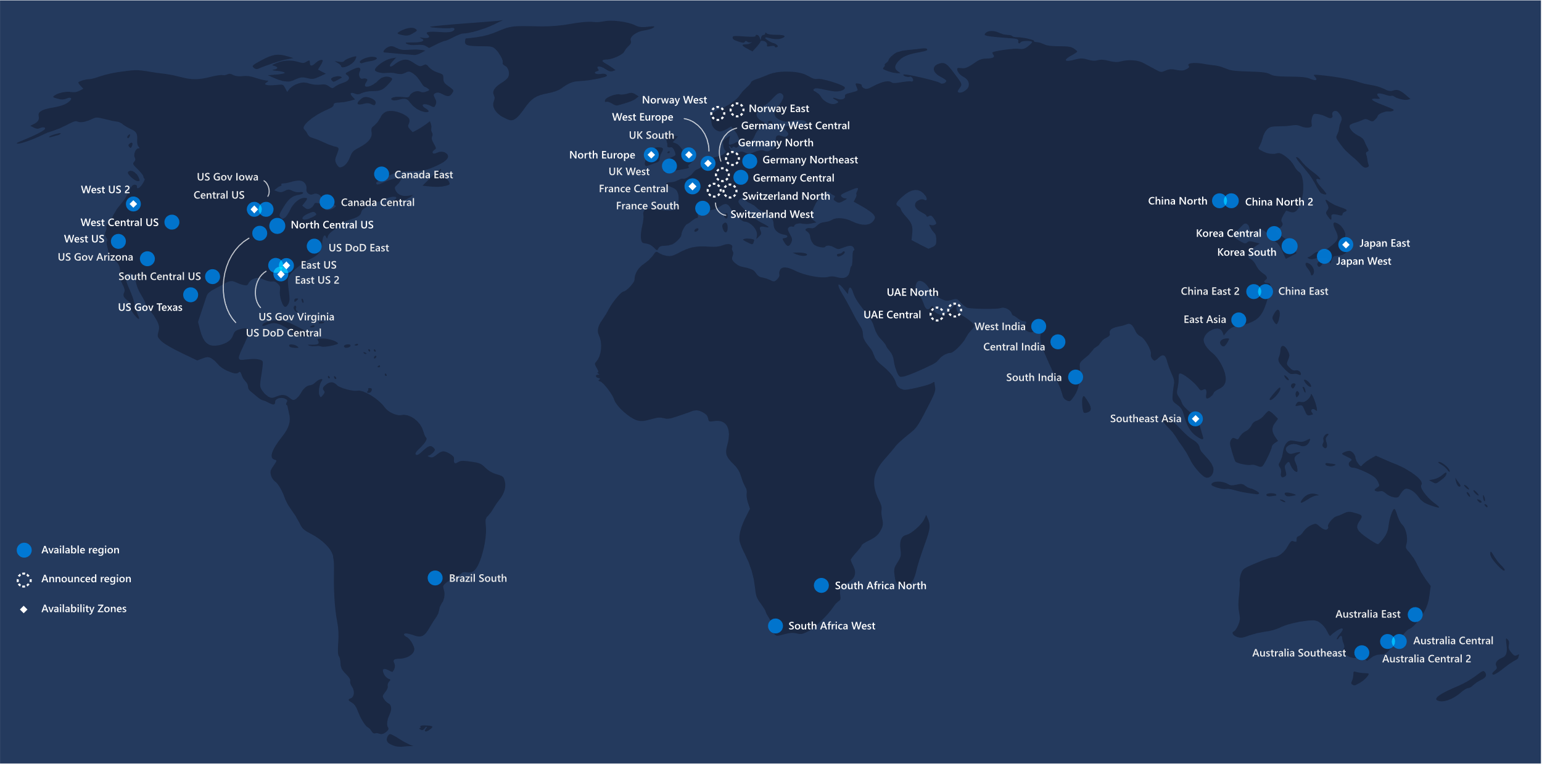
Behind the Physical Curtain

Slide 9
Physically speaking

Slide 10
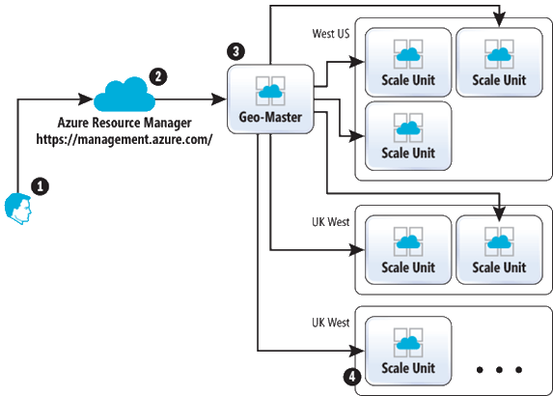
Scale units
https://msdn.microsoft.com/en-us/magazine/mt793270.aspx

Slide 11
Scale units - a.k.a stamps
Front end load balancer
Management (SQL, Data, Publishers)
Your App Services
My App Services
Web Worker Pool

Slide 12
Scale units - a.k.a stamps
Front end load balancer
Management (SQL, Data, Publishers)
Your App Services
My App Services
Web Worker Pool

Slide 13
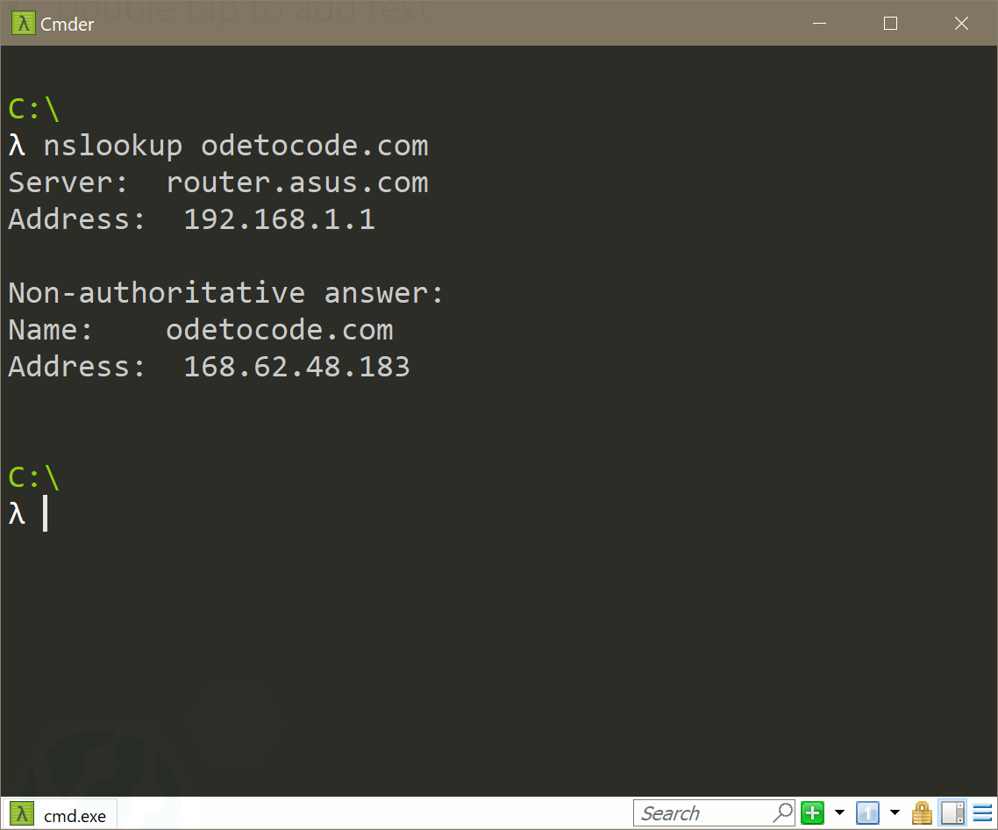
Which stamp?

Slide 14
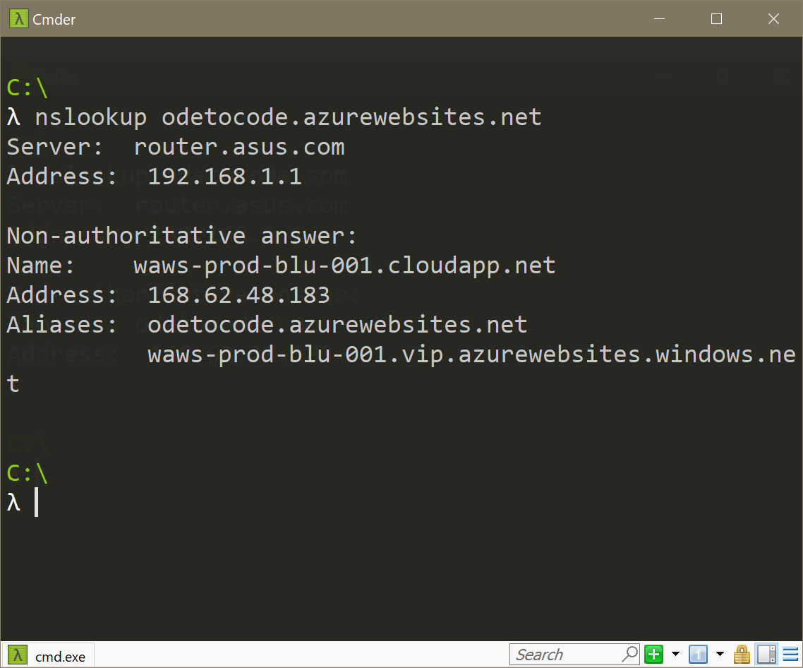
Which stamp?

Slide 15
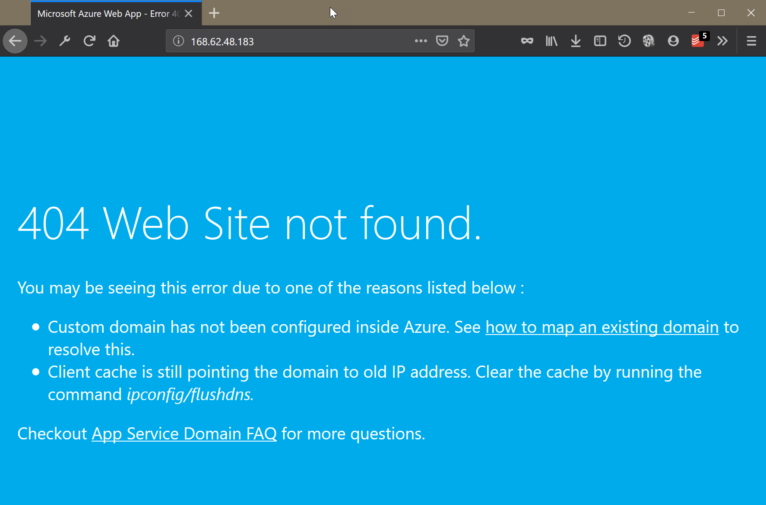
Which stamp?

Slide 16
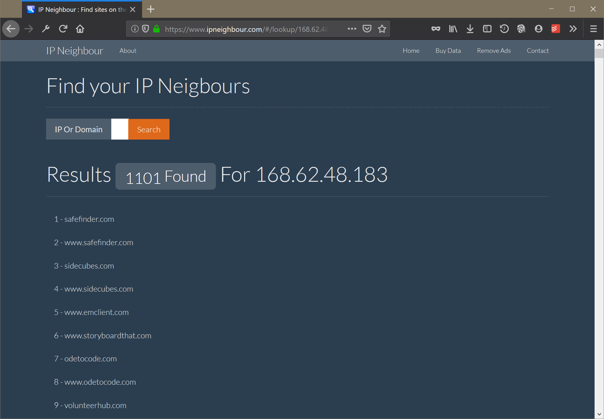





Slide 18

Logically Speaking
This Photo by Unknown Author is licensed under CC BY-SA

Slide 19
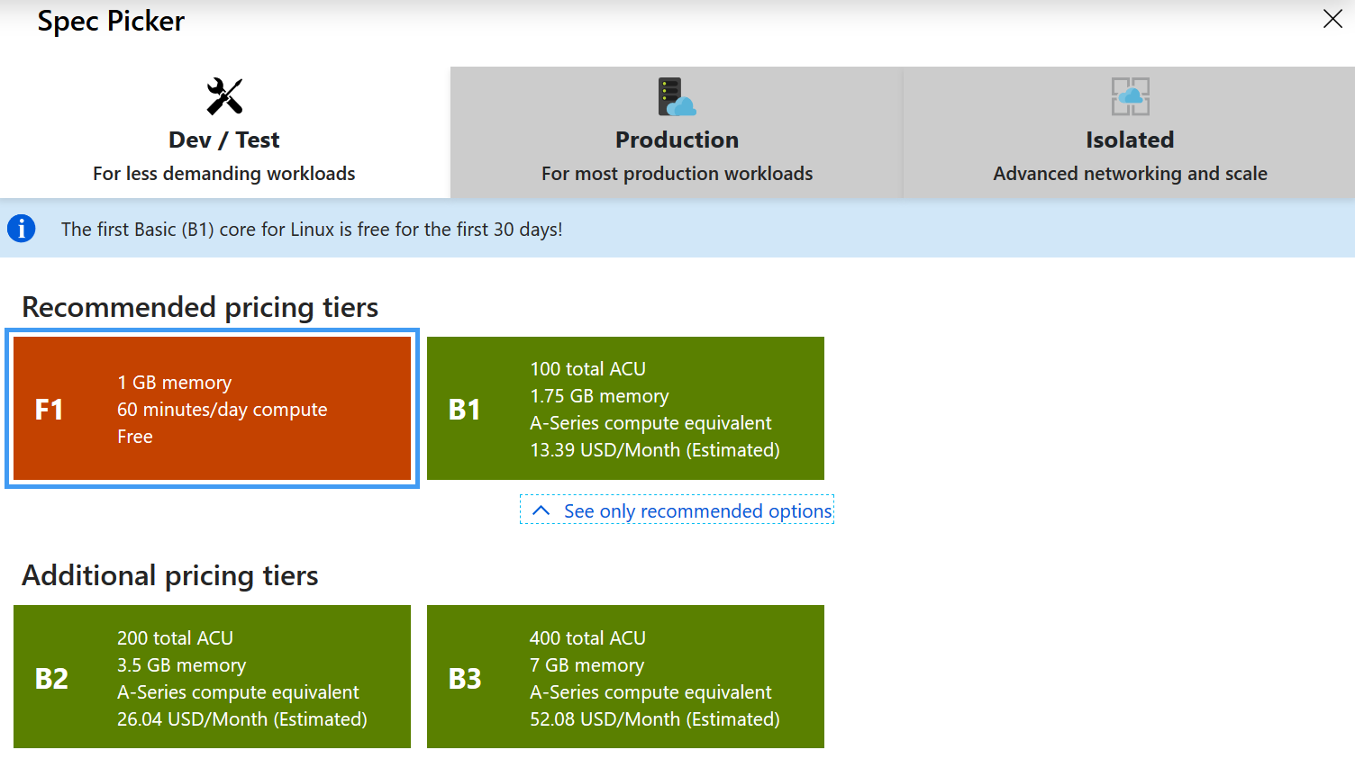
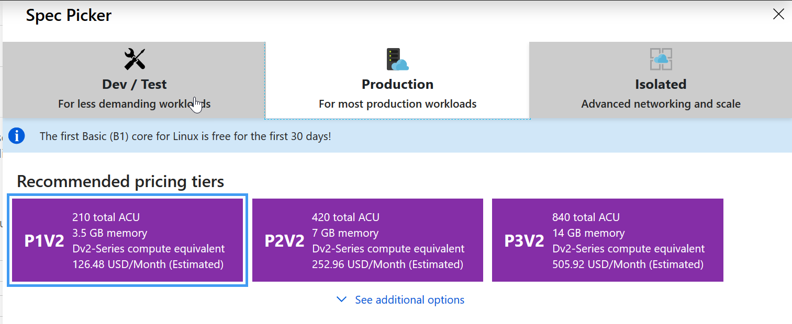
App Service Plan == VM

Slide 20
App Service Plan == VM

Slide 21

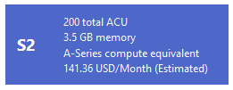
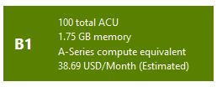


Slide 23
Control your density!

Slide 24
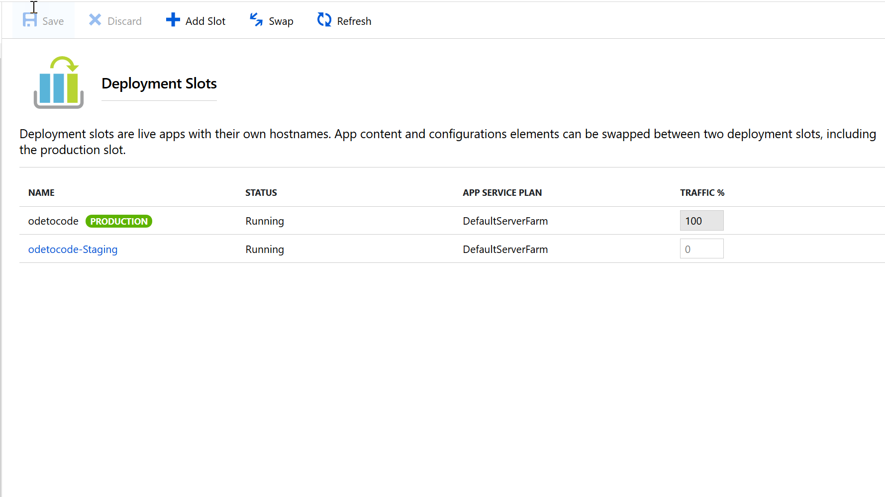

Slide 25
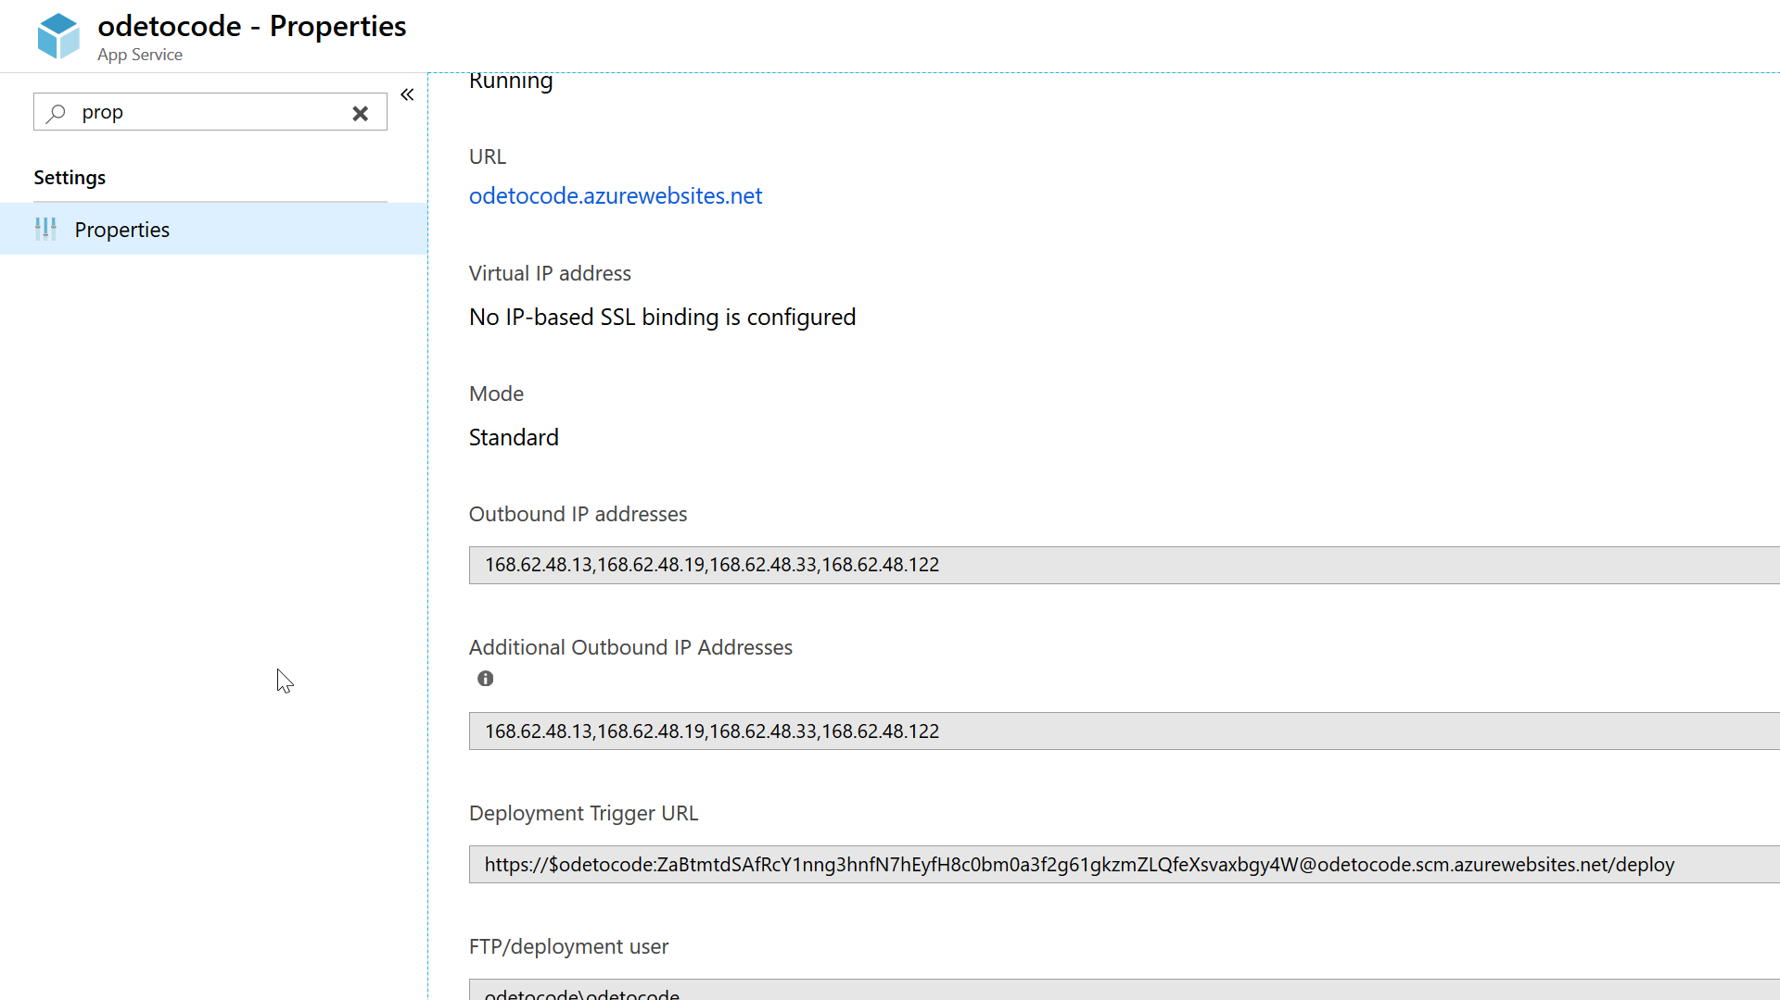

Slide 26
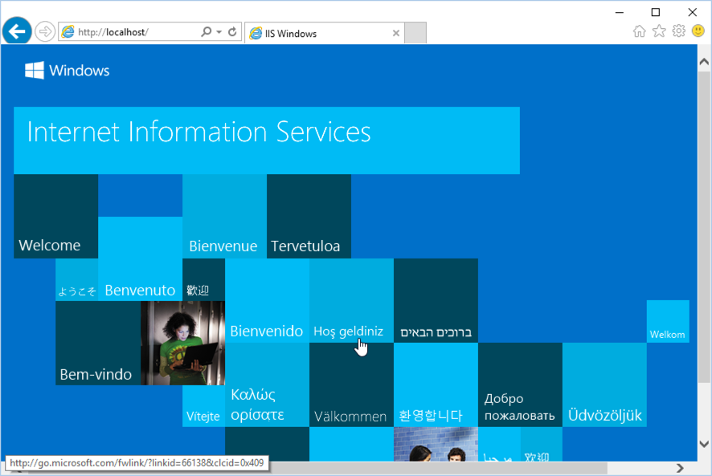
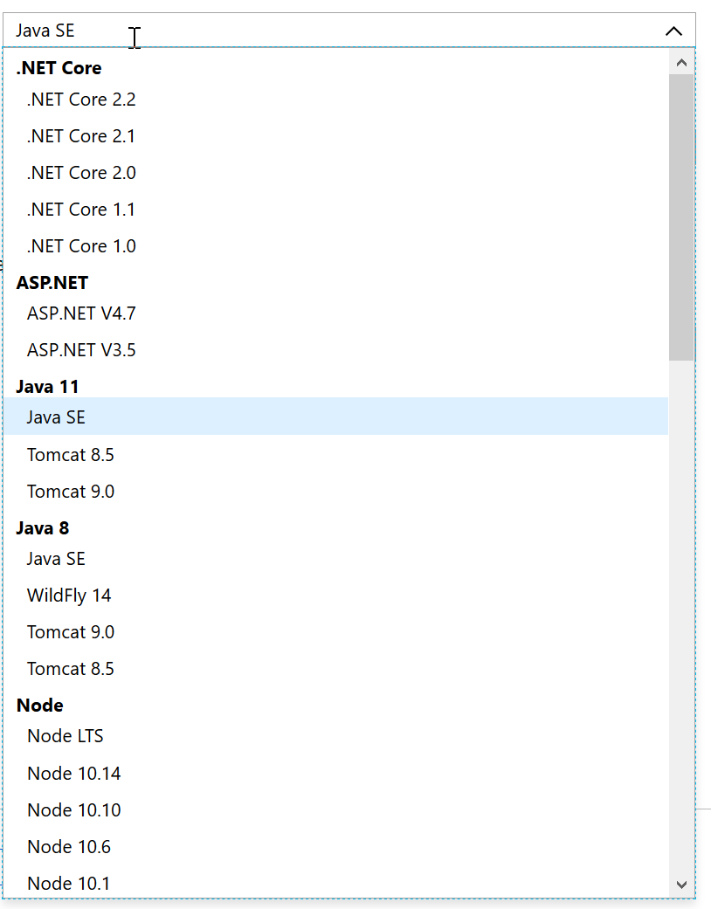
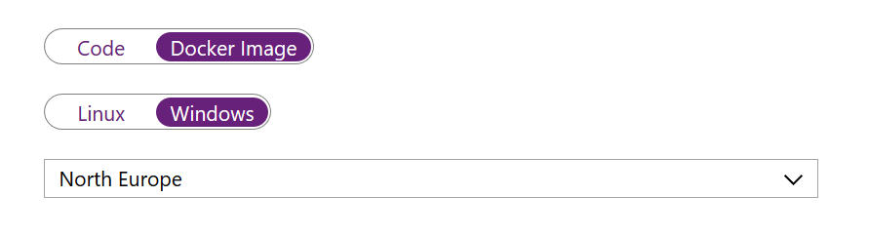
What’s In the VM?
Windows App Service
Linux App Service
Container App Service

Slide 27
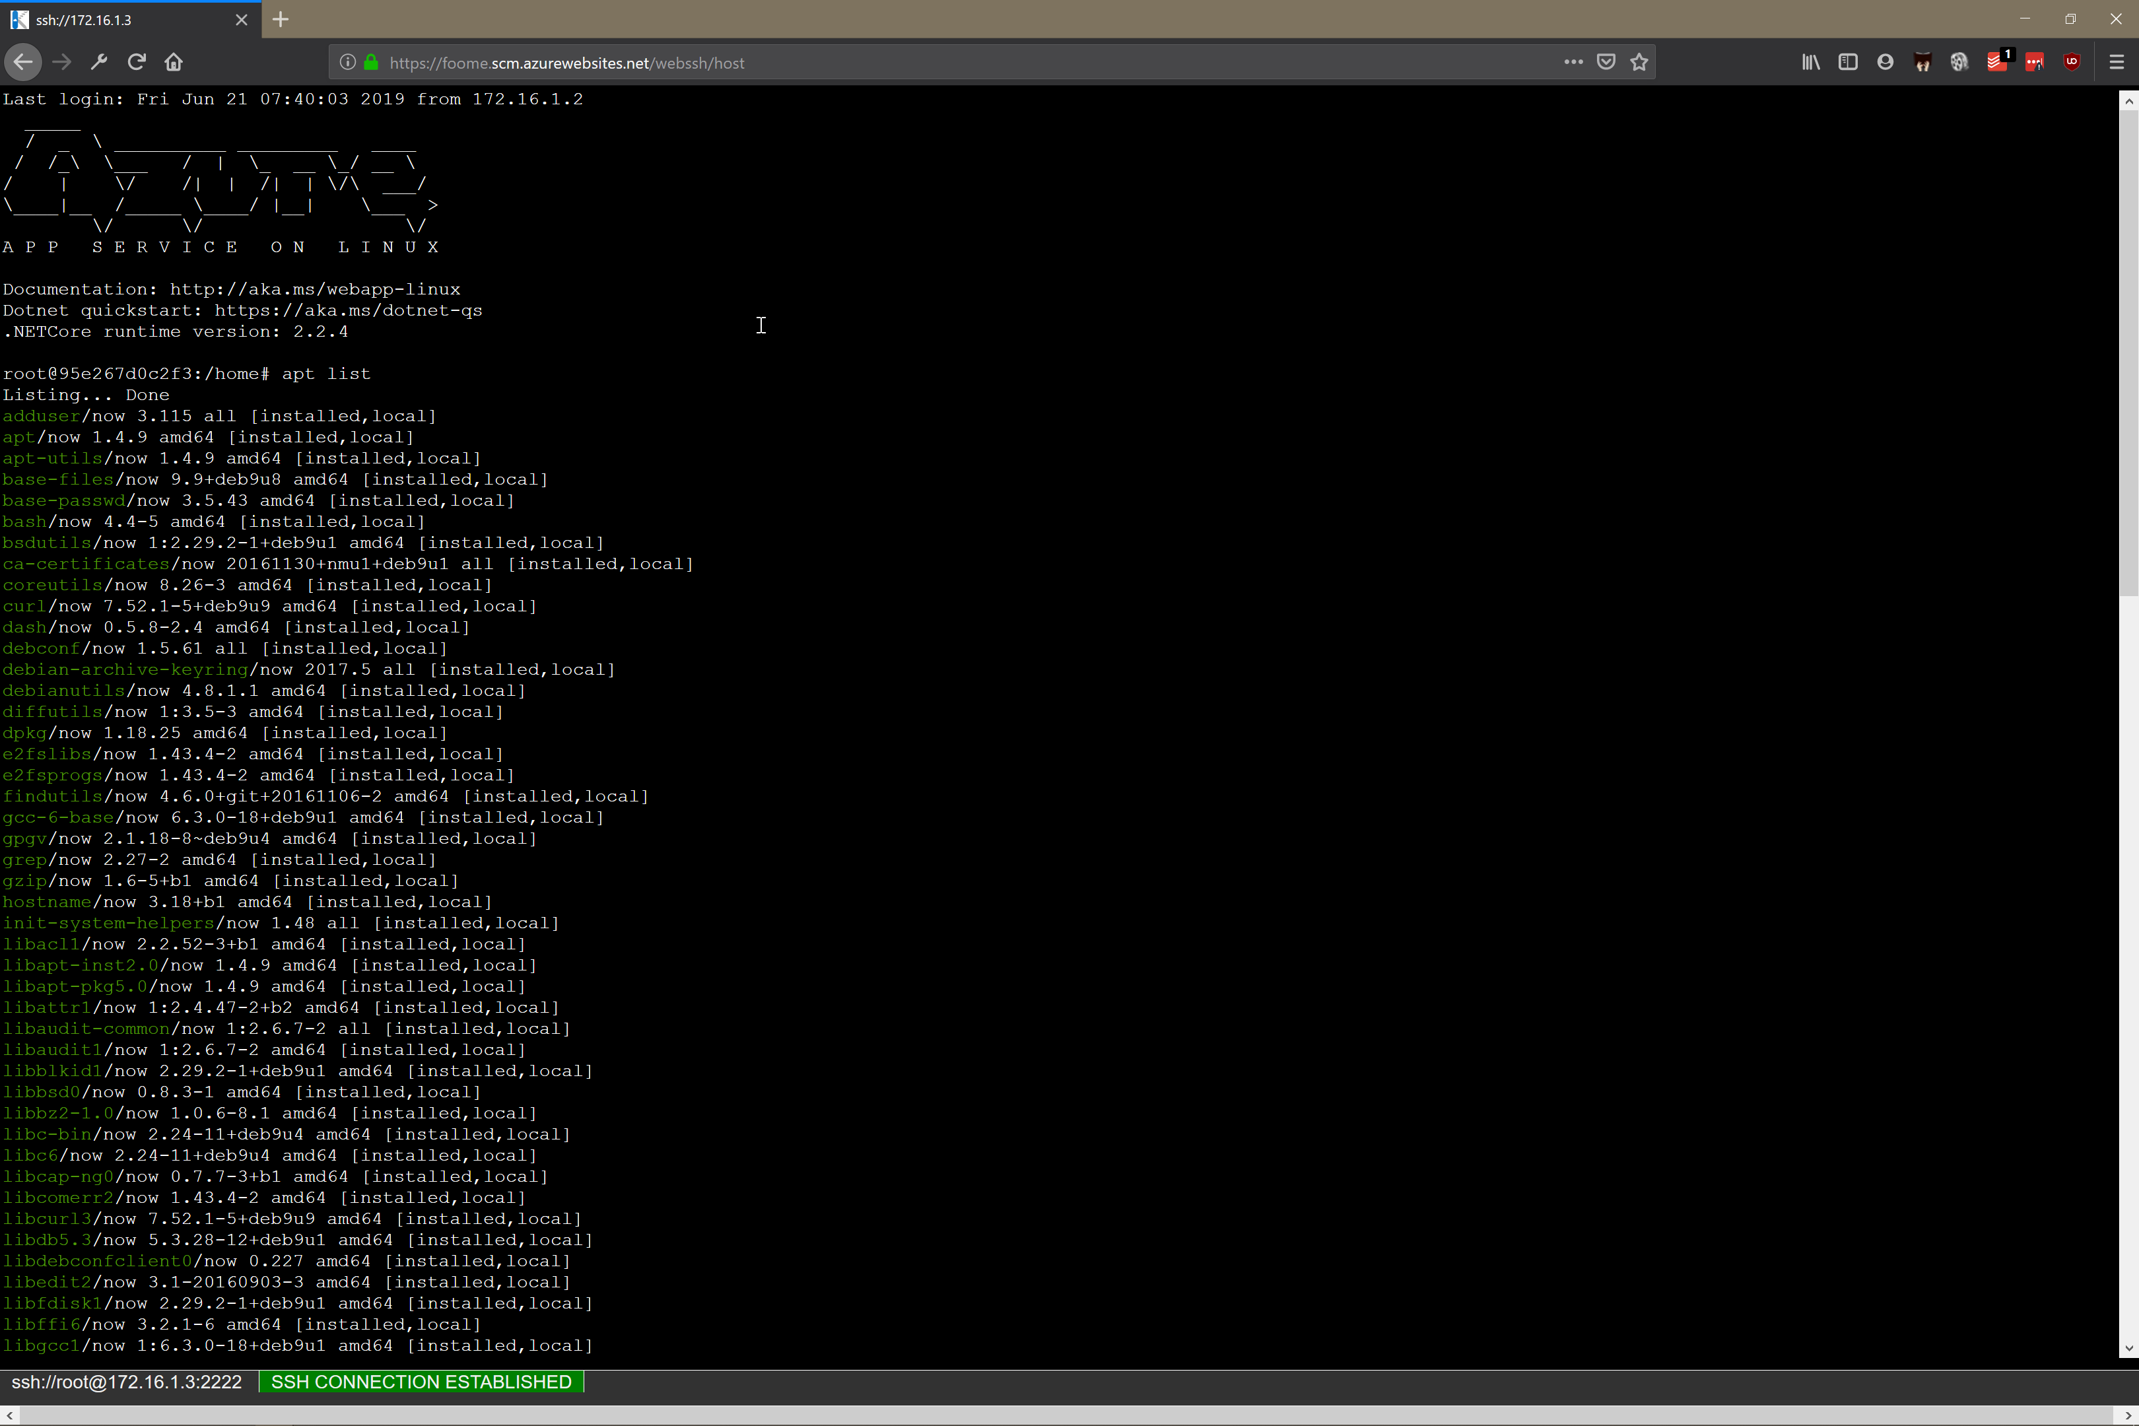
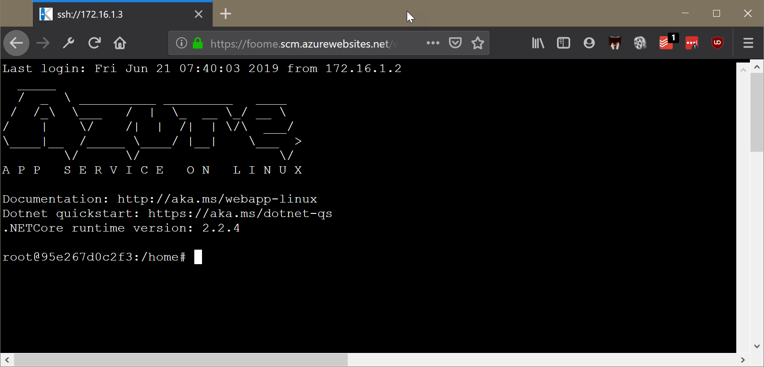
Getting Into the VM

Slide 28
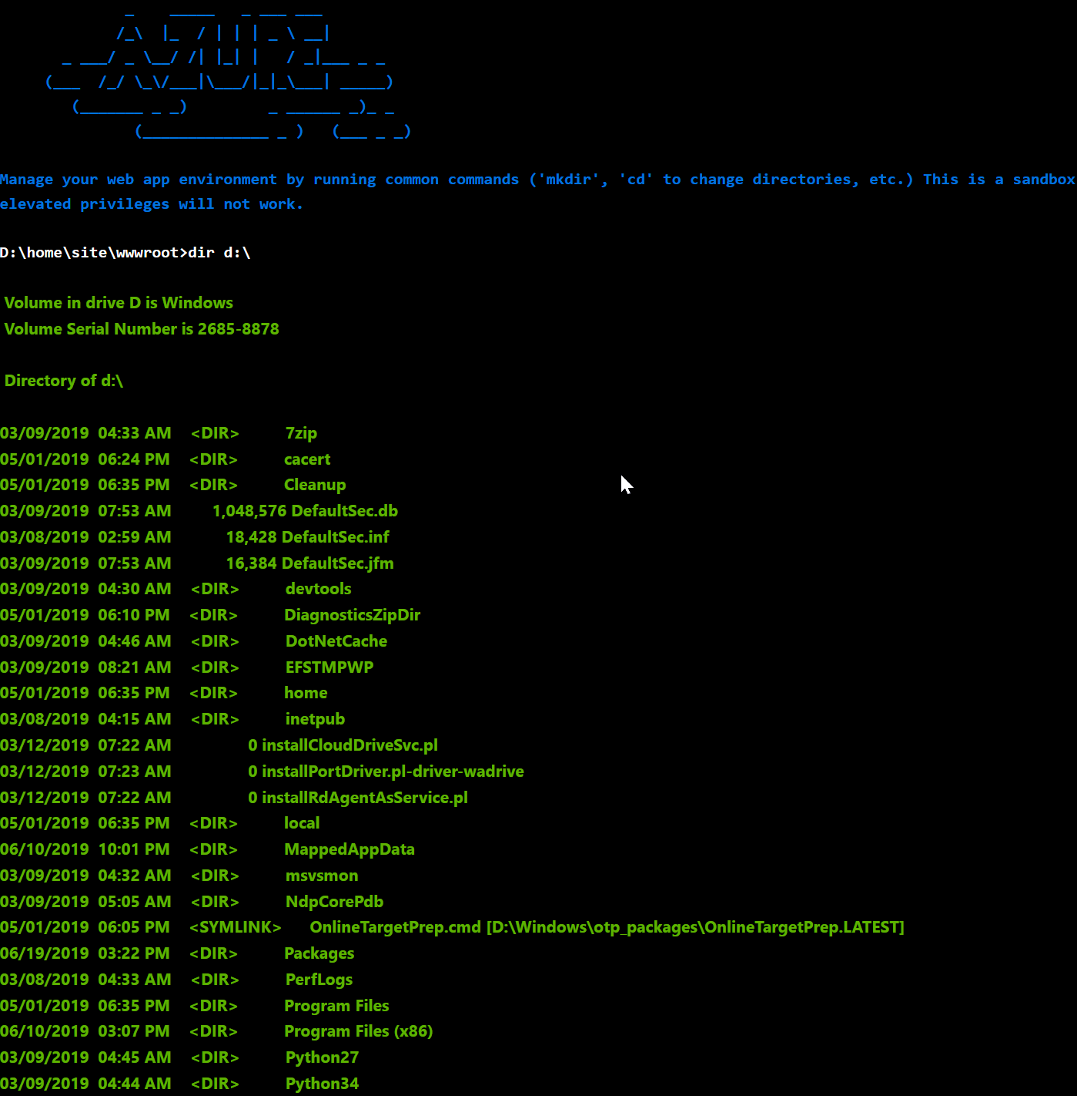
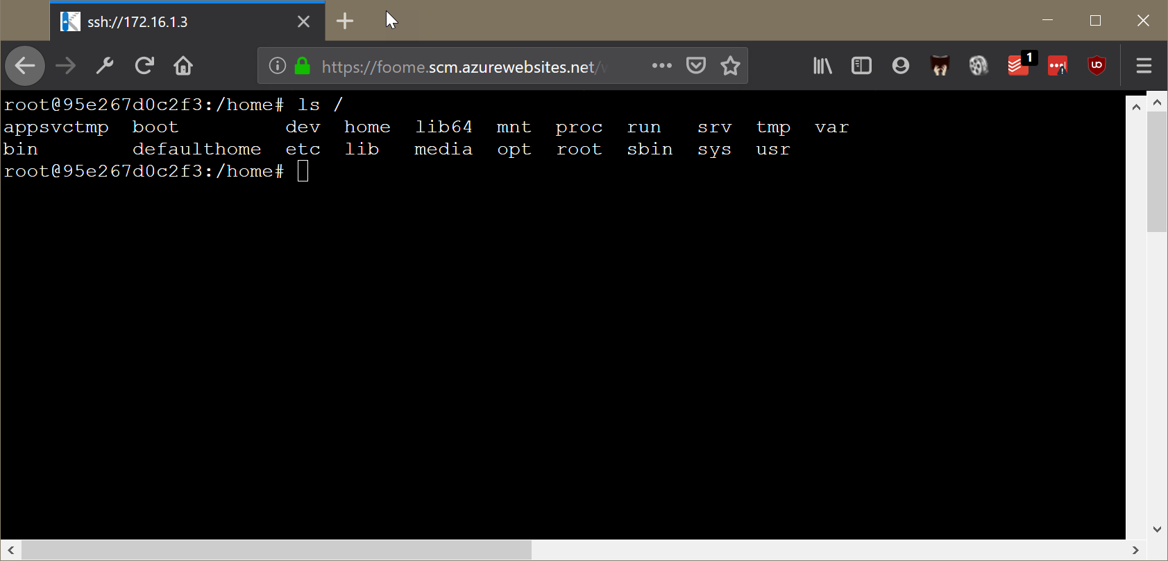
The File System

Slide 29

The File System
Persisted files live in %HOME%

Slide 30
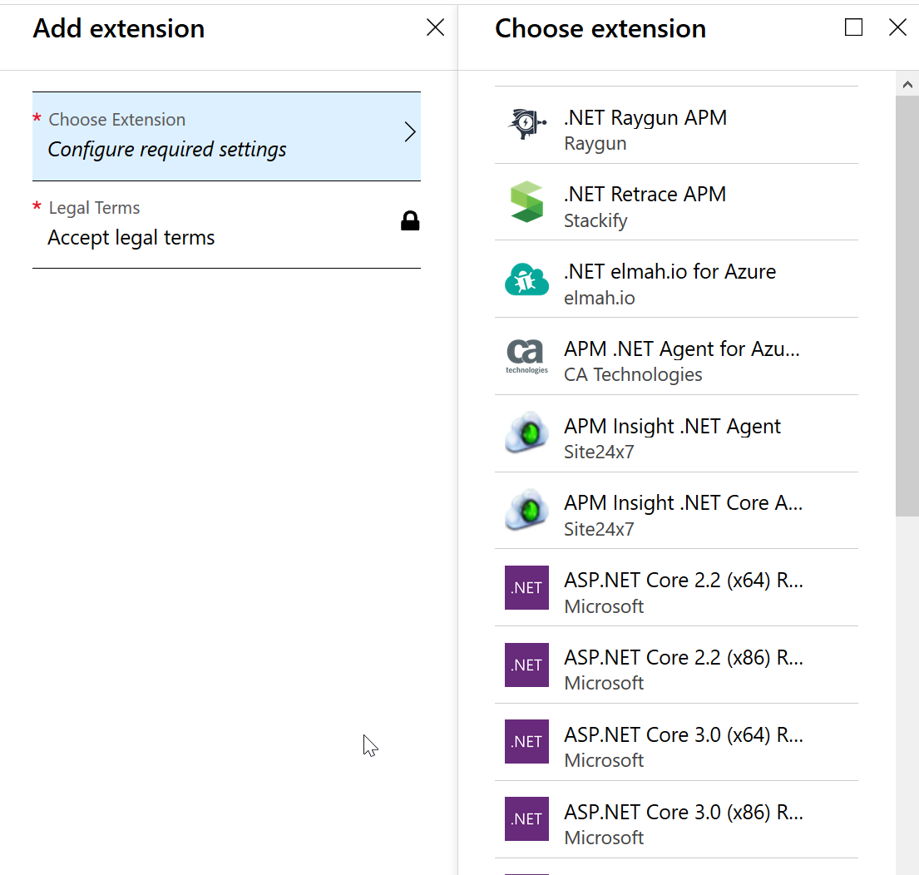
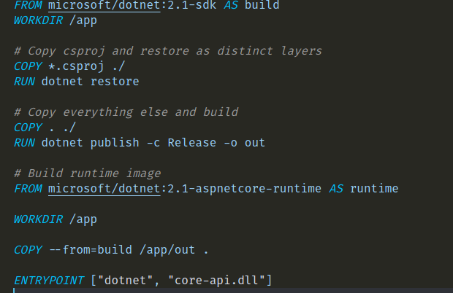
Customizing the Environment

Slide 31
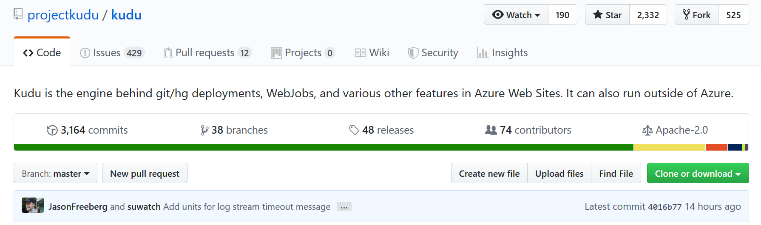
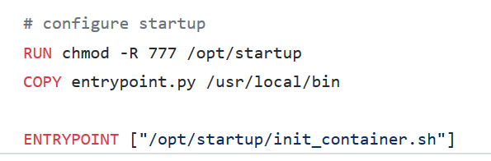
Deployment
Windows App Service
Local Git
Remote Git
FTP / FTPS / WebDeploy
Azure DevOps
Linux App Service
Local Git
Remote Git
FTP / FTPS
Azure DevOps
Container App Service
Any container registry

Slide 32
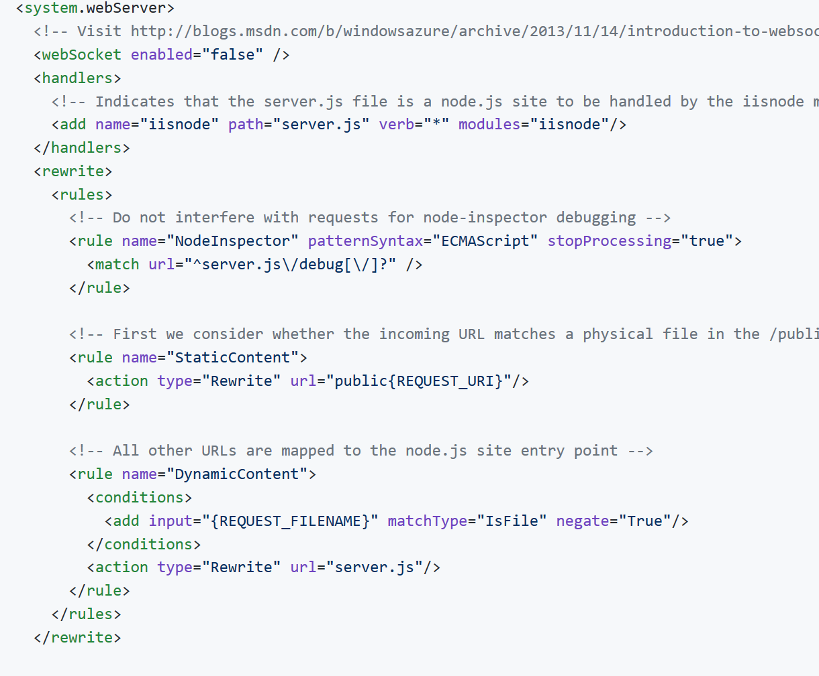

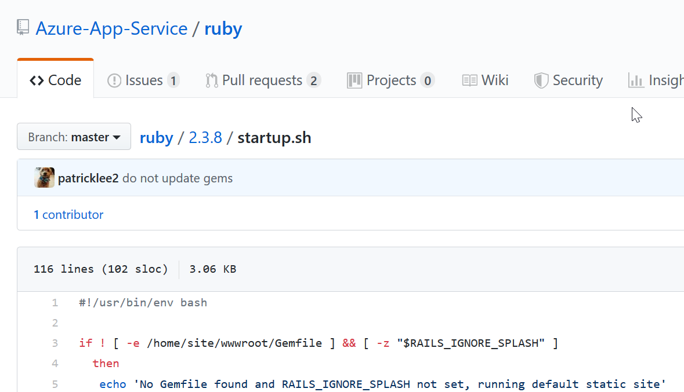
Custom App Launch
Windows App Service
Use web.config
Linux App Service
Many heuristics used
Is there a package.json?
Is there a gemfile?
Is there an application.py?
Set custom startup command
Container App Service
Do anything!
Set WEBSITES_PORT
Set WEBSITES_WEB_CONTAINER_NAME

Slide 34

Performance
This Photo by Unknown Author is licensed under CC BY-SA

Slide 35
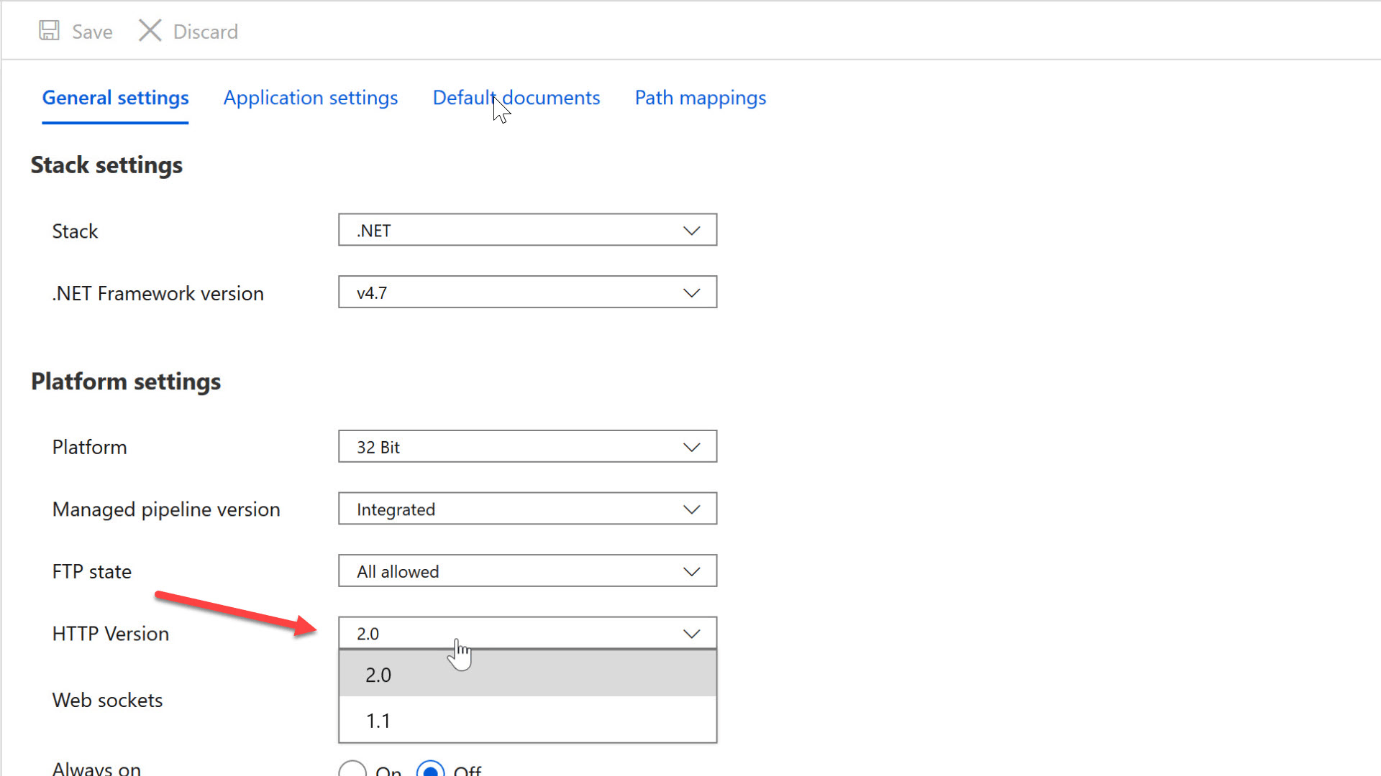
Performance Tips
Enable HTTP/2

Slide 36
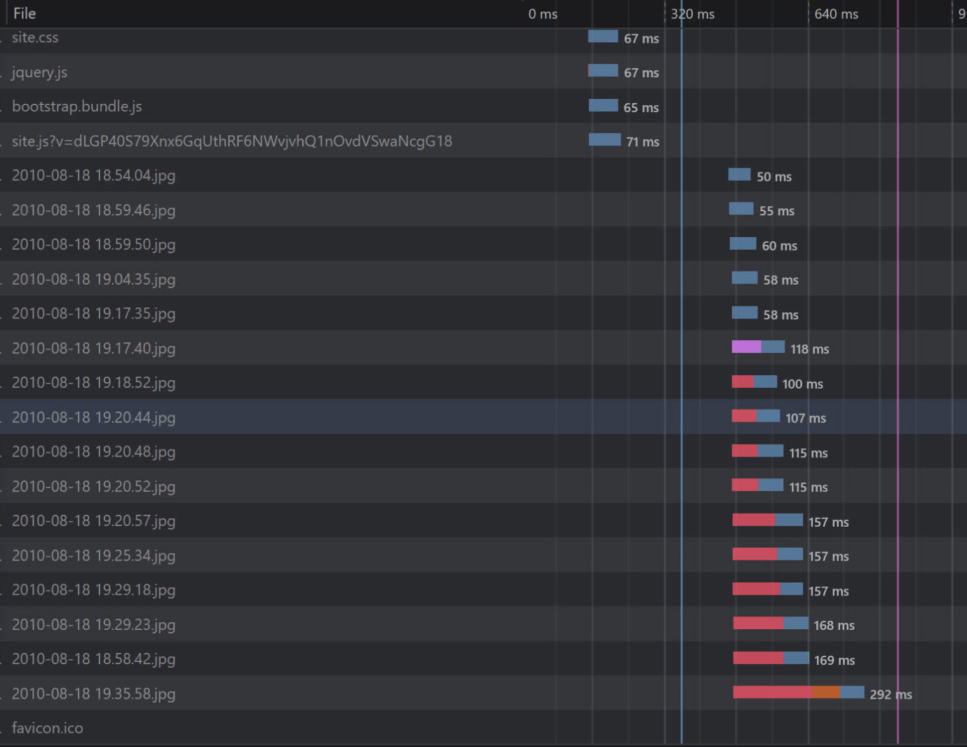
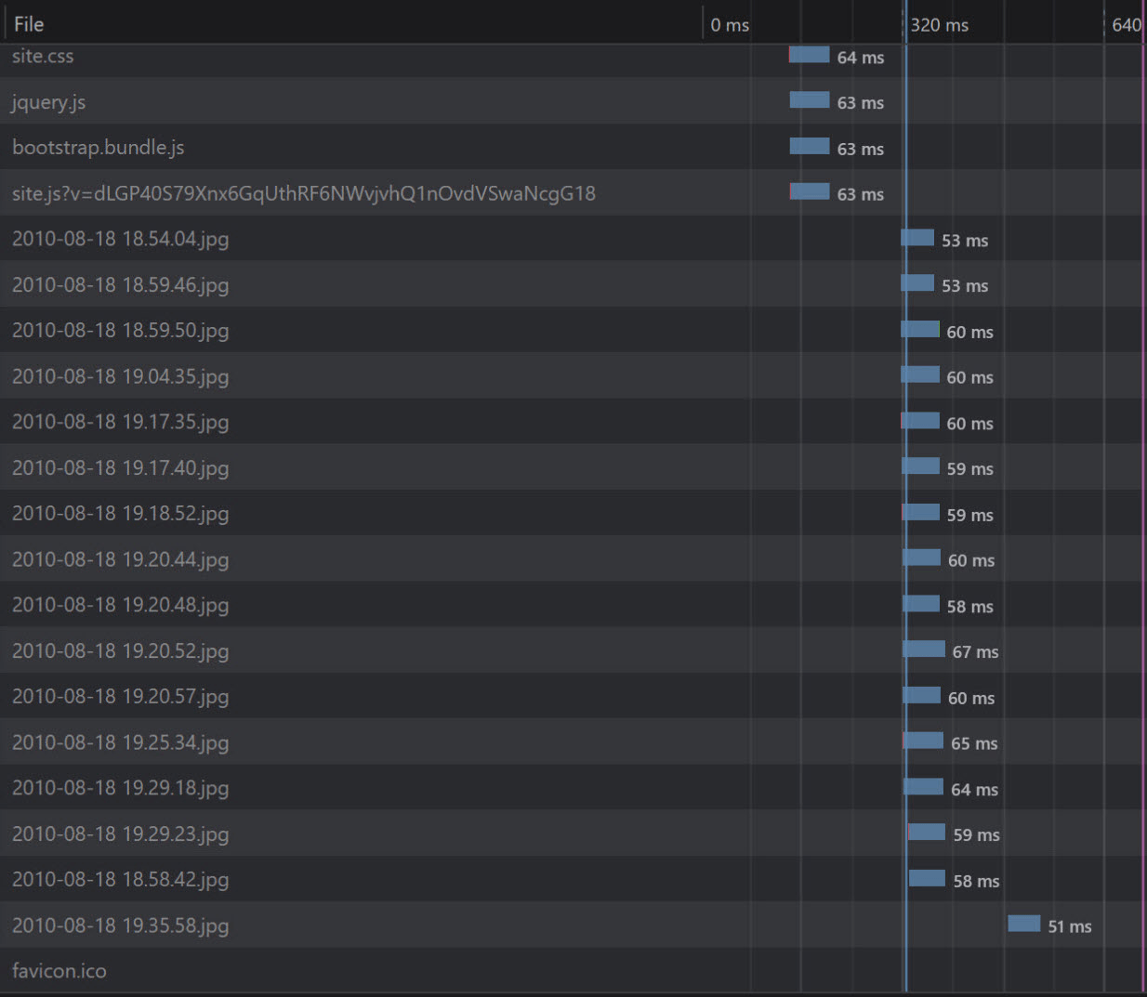
Performance Tips
Enable HTTP/2

Slide 37
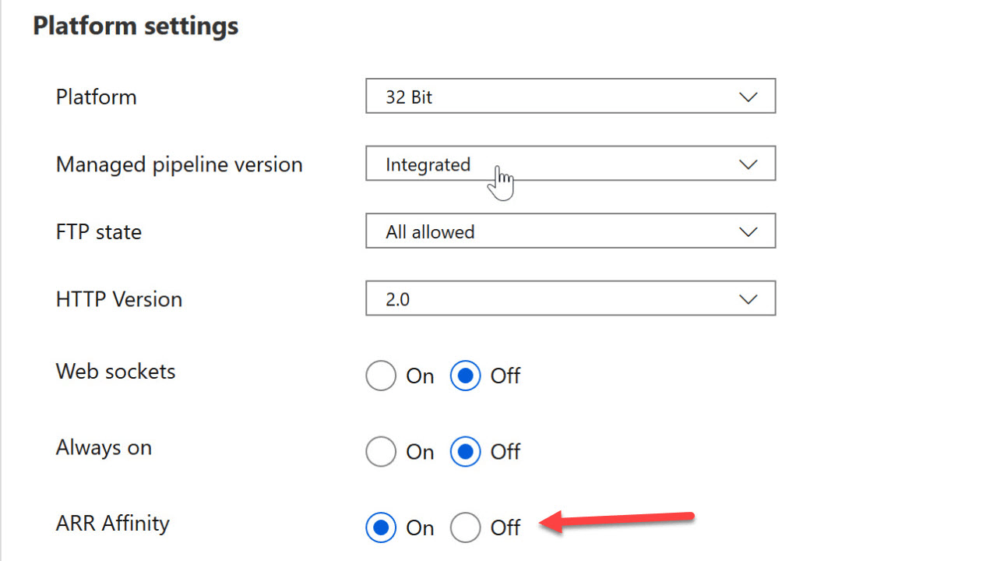
Performance Tips
Turn off Application Request Routing

Slide 38
Performance Tips
Turn off Application Request Routing

Slide 39
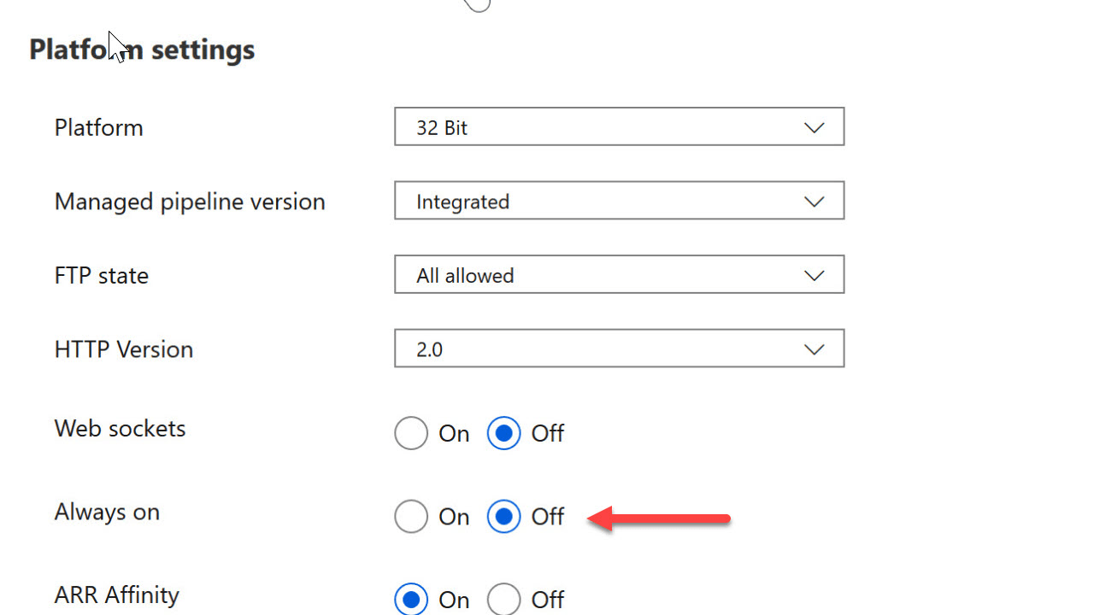
Performance Tips
Keep the App Service Always On

Slide 40
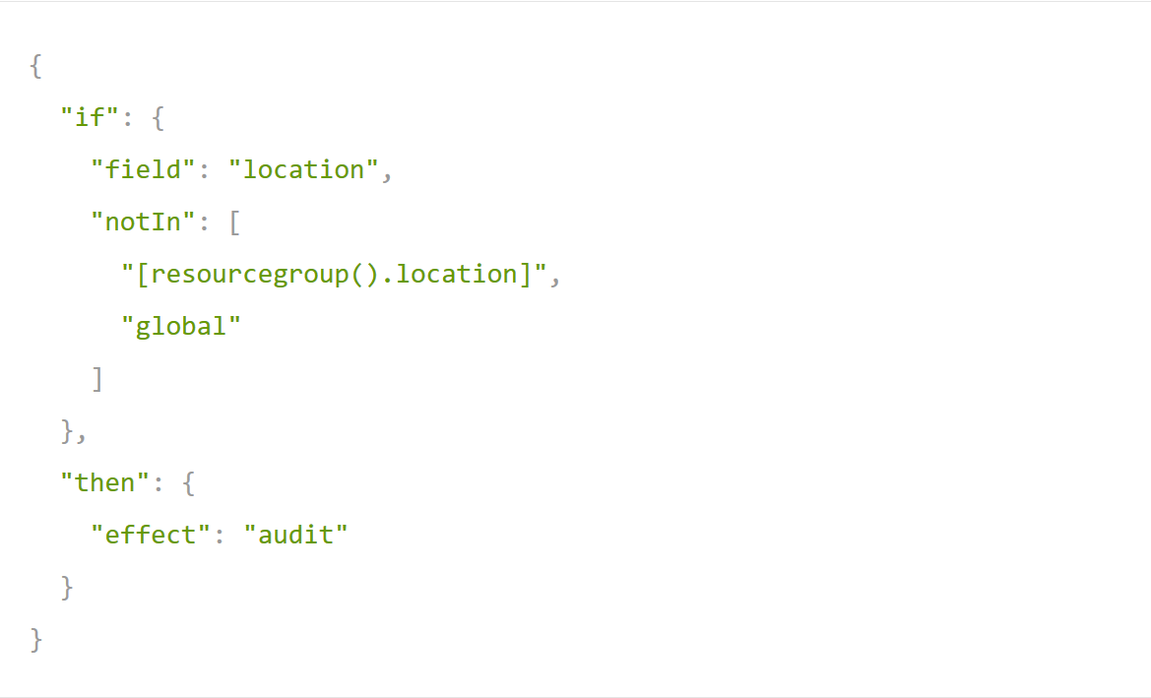
Performance Tips
Keep dependencies close

Slide 41
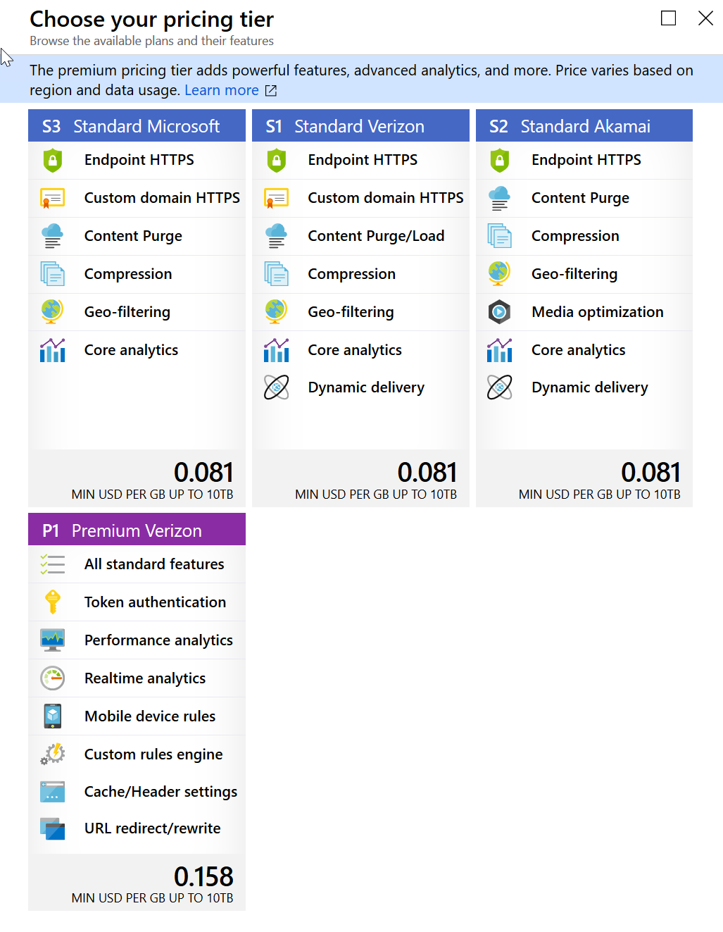
Performance Tips
Keep assets close to customers

Slide 42
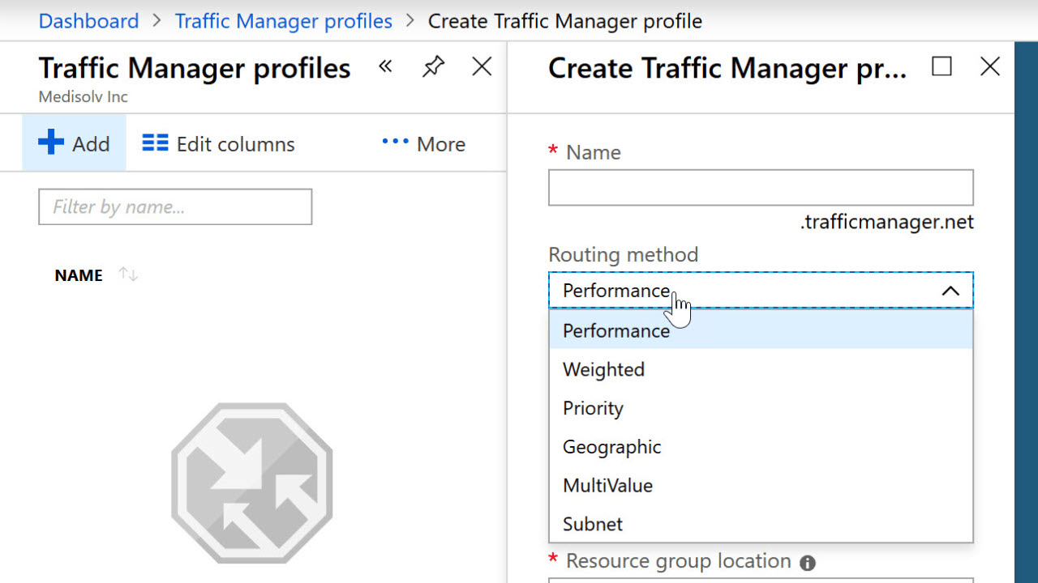
Performance Tips
Keep App Service close to customers with Traffic Manager

Slide 43
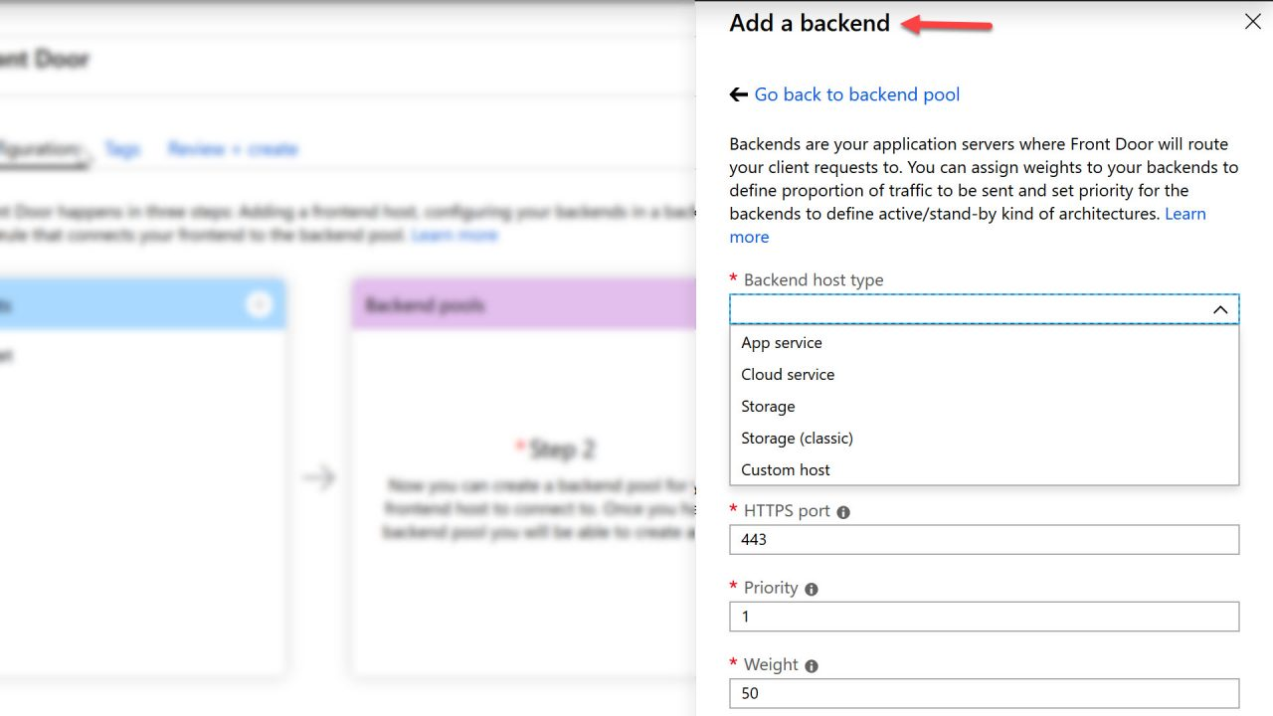
Performance Tips
Keep App Service close to customers with Front Door

Slide 44
Front Door versus Traffic Manager
Traffic Manager
Front Door Service
DNS Based
Cheap
Easy
Does health monitoring
Different routing methods
Latency
Geographical
Weighted
Slow to failover
A Proxy
Uses IP Anycast
Instant failovers
Intelligent caching
Dynamic site acceleration
Network optimizations

Slide 46
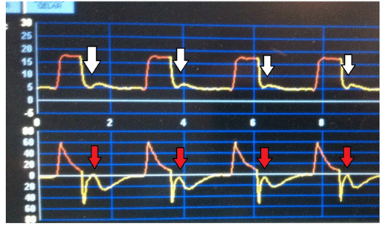
Diagnostics
This Photo by Unknown Author is licensed under CC BY

Slide 47
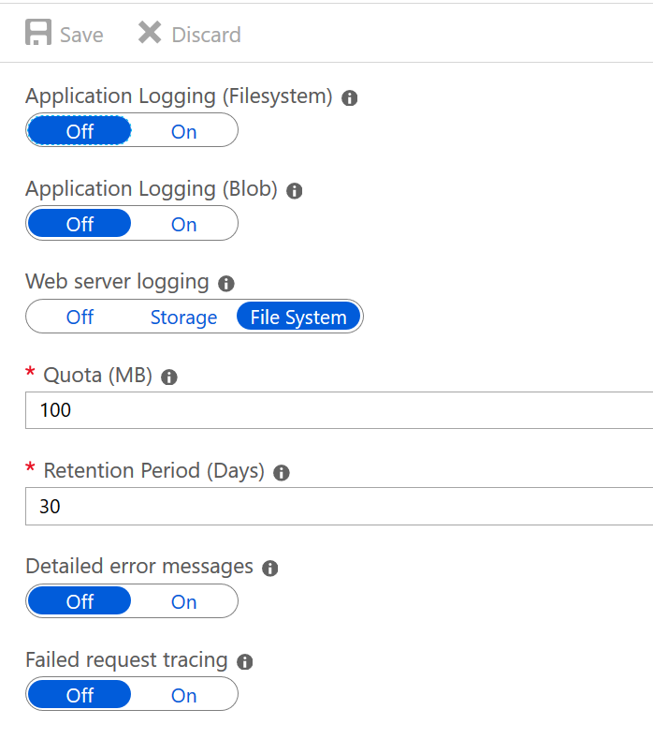
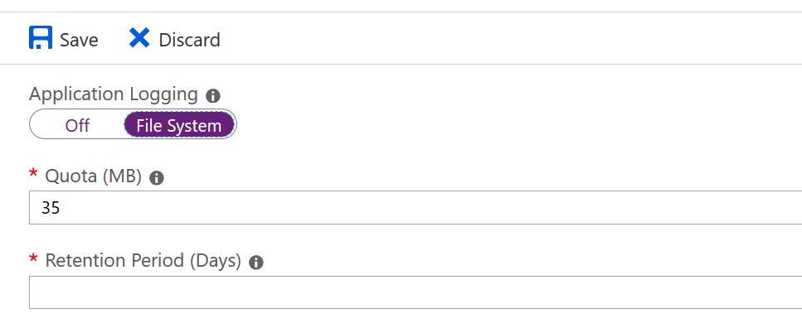
Diagnostics

Slide 48
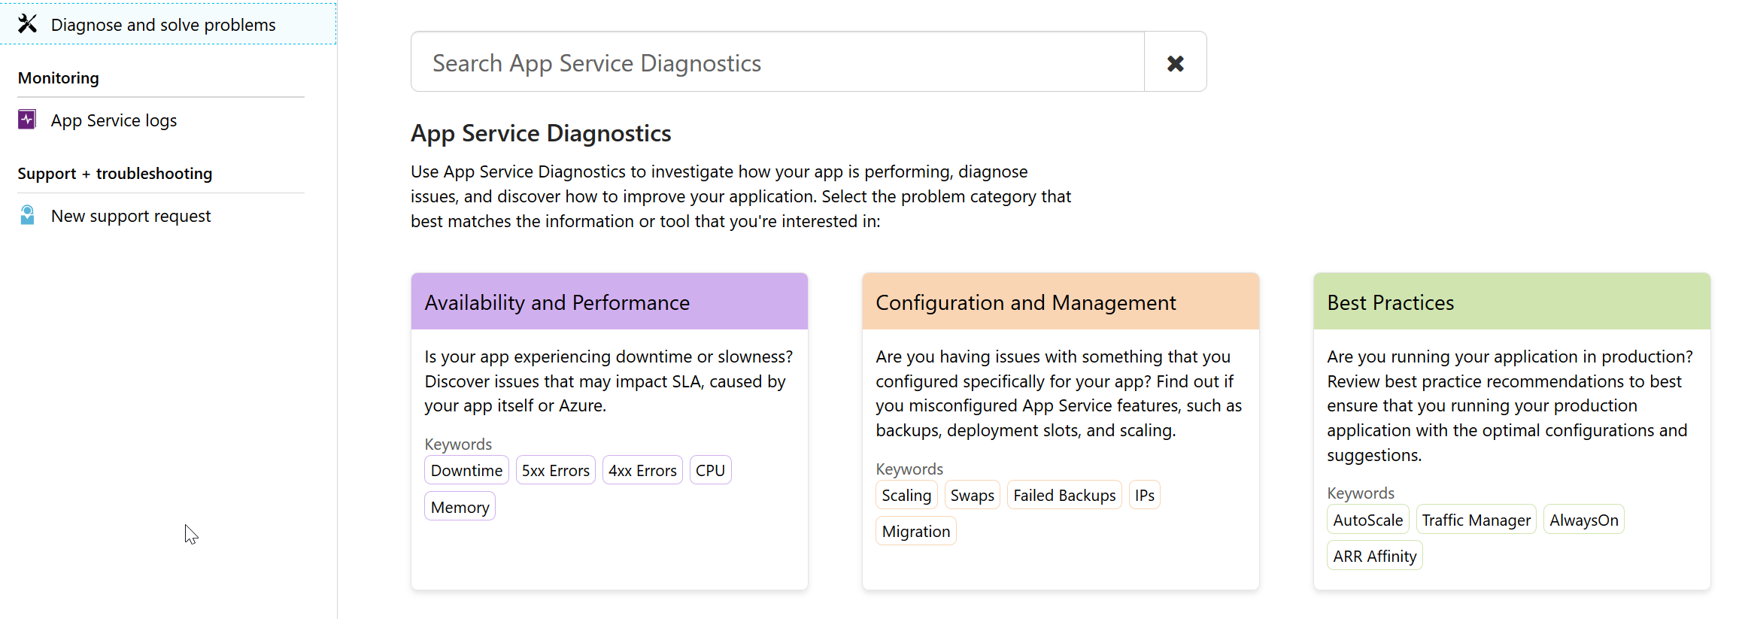
Diagnostics

Slide 49
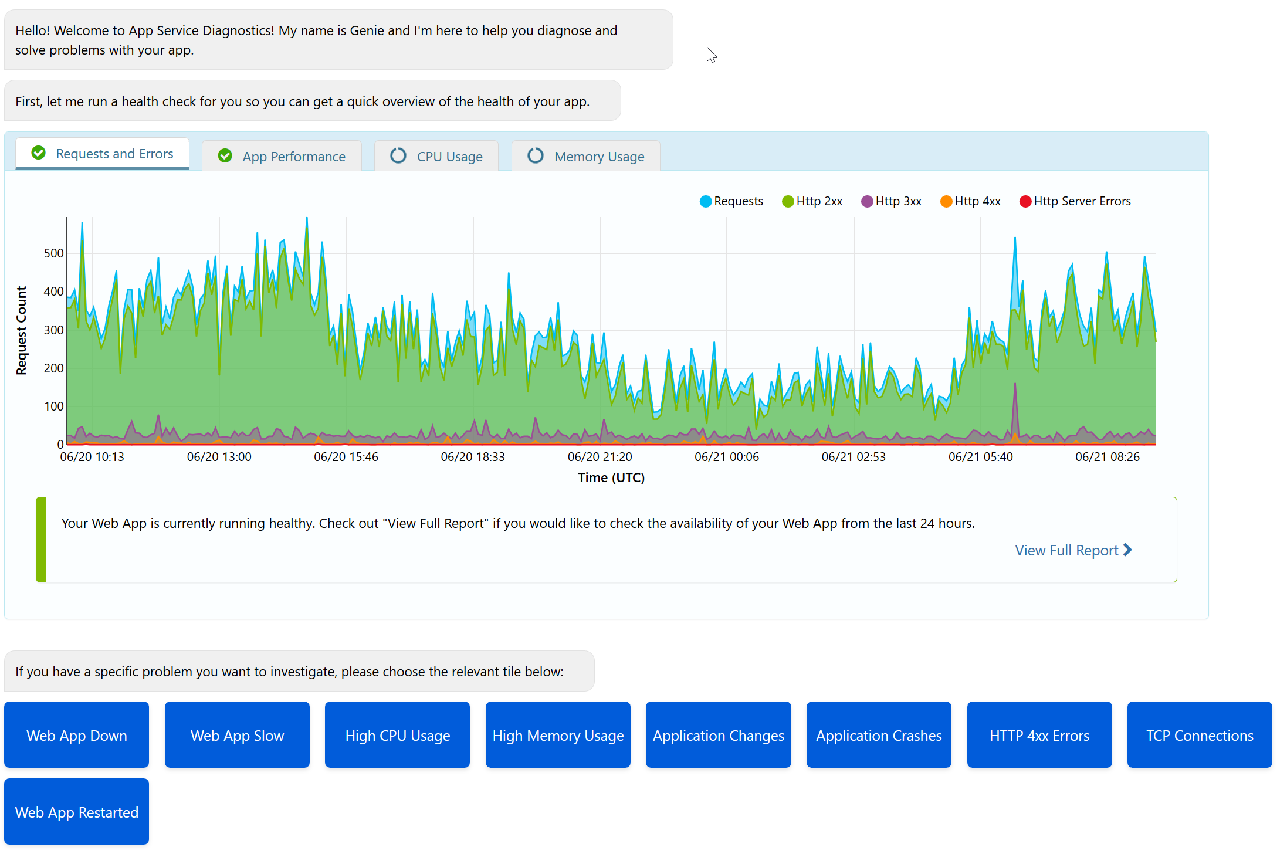
Diagnostics

Slide 50
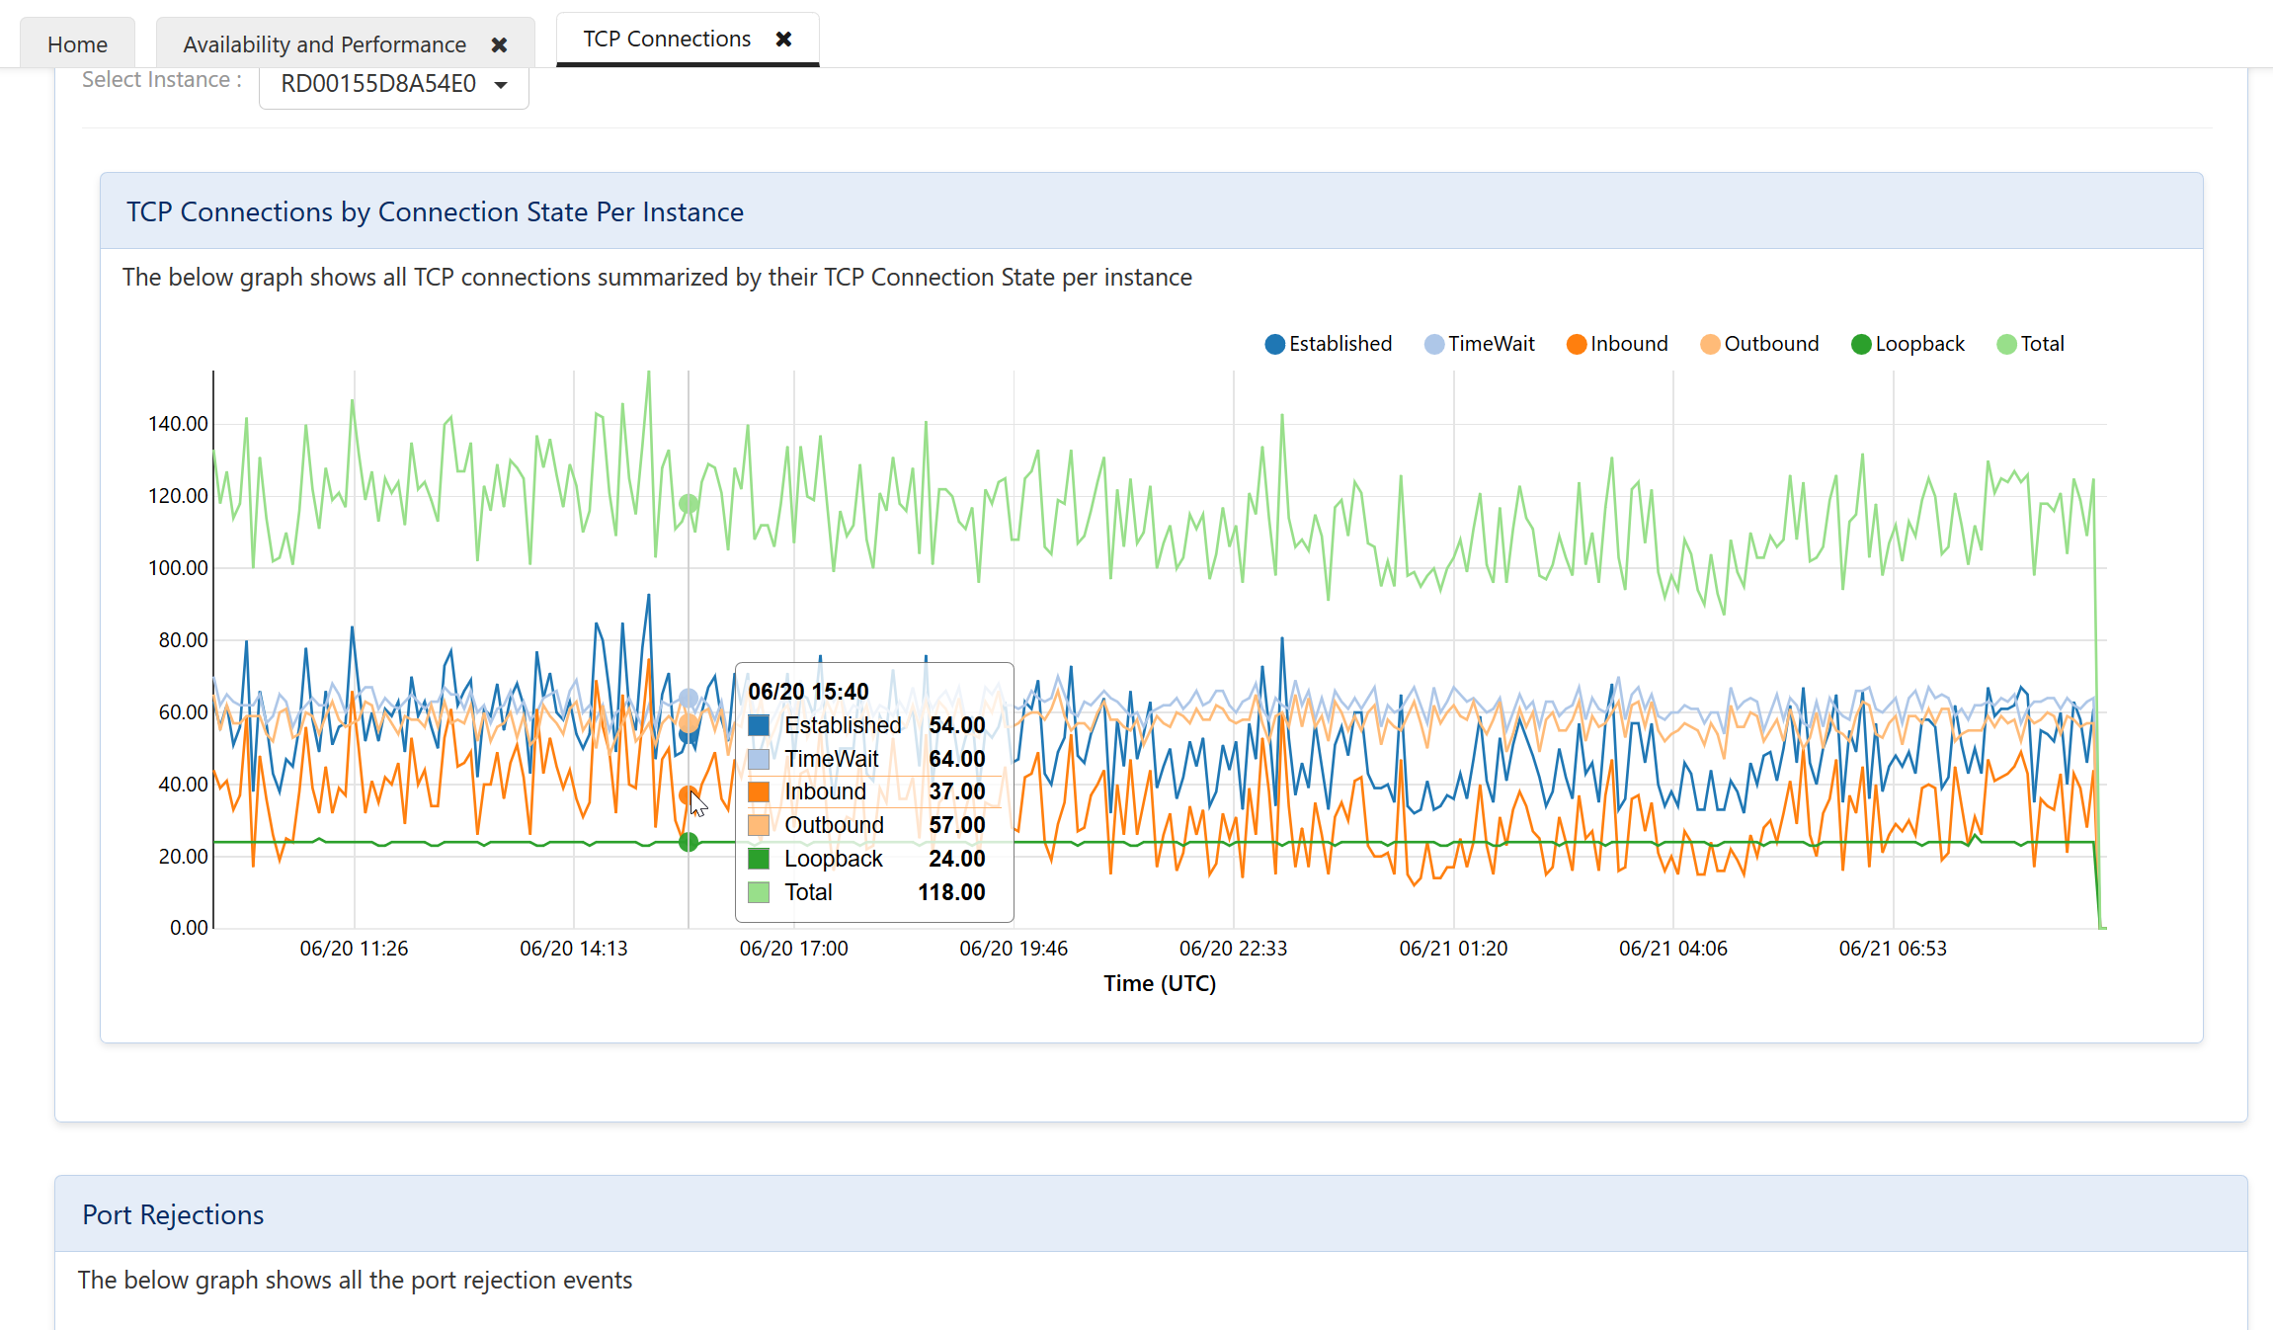
Diagnostics

Slide 51
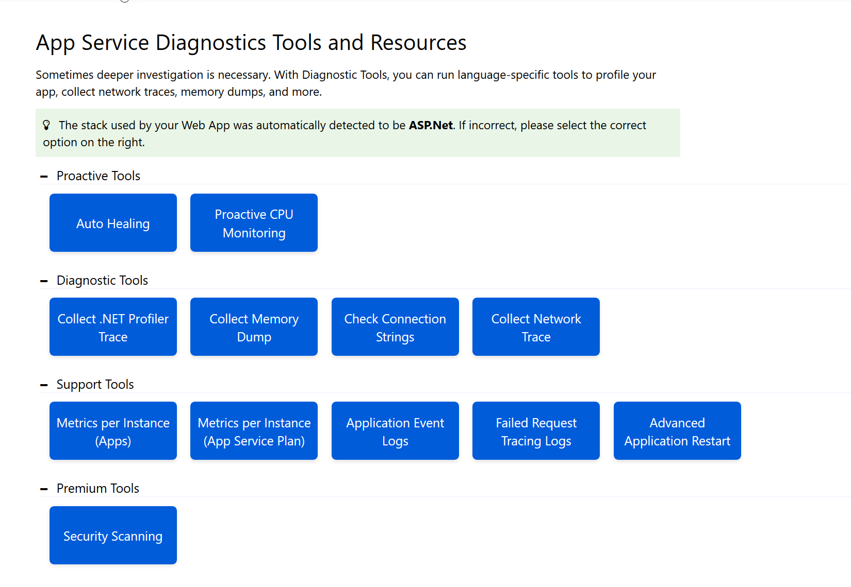
Diagnostics

Slide 53

The End scott@OdeToCode.com @OdeToCode
This Photo by Unknown Author is licensed under CC BY-SA

